Slide 1
WEB TECHNOLOGY
PROJECT PRESENTATION

Slide 2
BUSINESS REGISTRATION AND BOOKING SYSTEM
PROJECT TITLE
MEMBERS NAME:
1.ABDULLAH REHMAN (21-ARID-536)
2.AHMED FRAZ (21-ARID-538)
3.MALAIKA SAJID (21-ARID-589)

Slide 3
Tools and Technology
VS CODE
SUBLIME TEXT
WAMP SERVER
Database
Languages Used
HTML
CSS
JQUERY /JAVASCRIPT
PHP
MY SQL

Slide 4
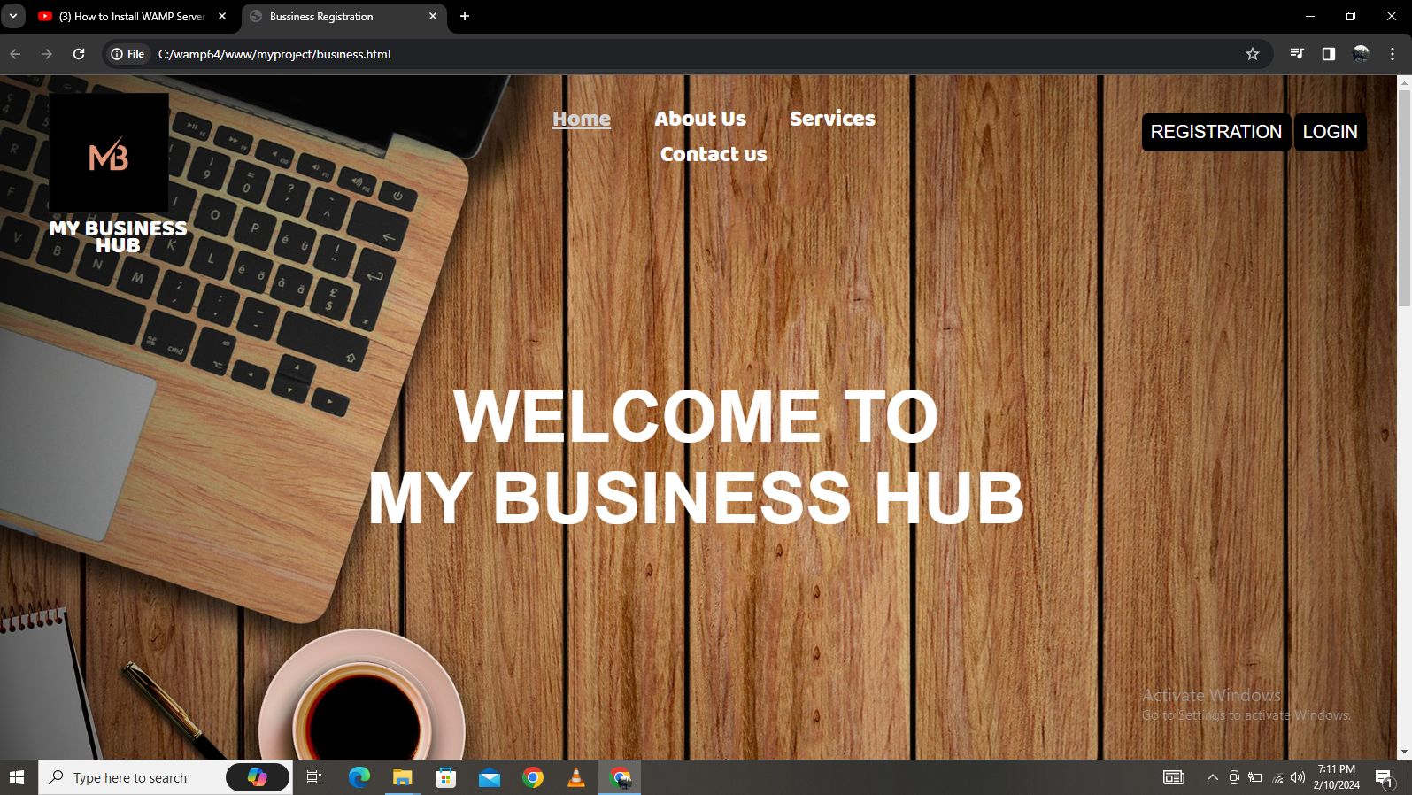
FRONT END PAGES(USER INTERFACE)
HOME PAGE:

Slide 5
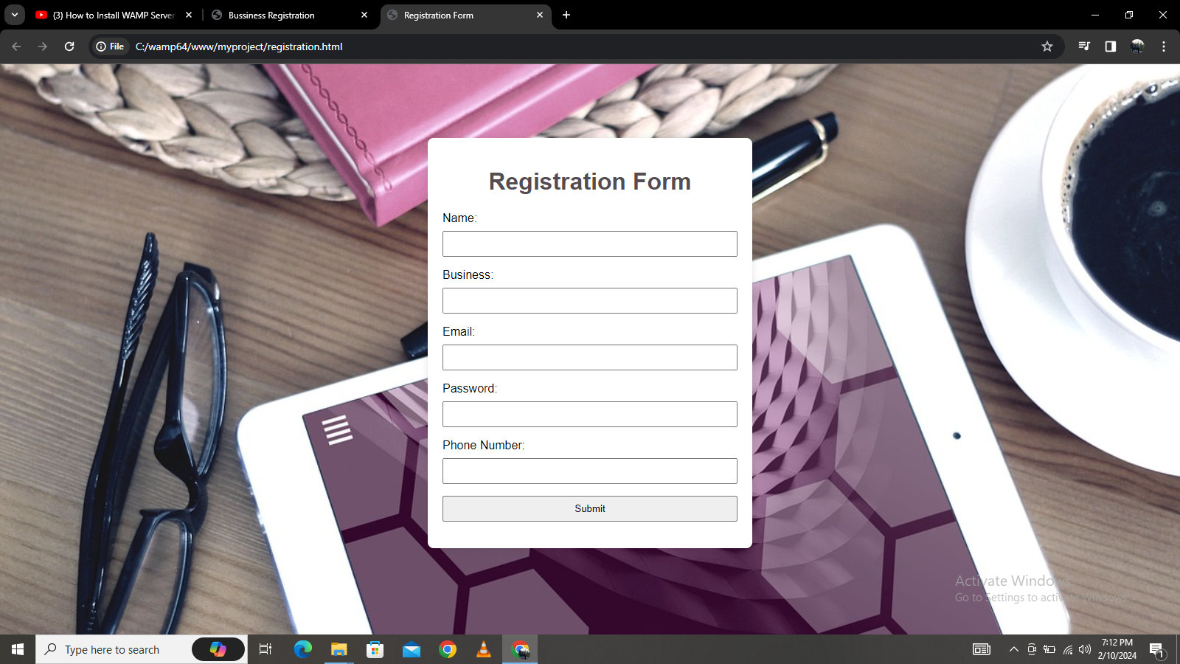
REGISTRATION PAGE

Slide 6
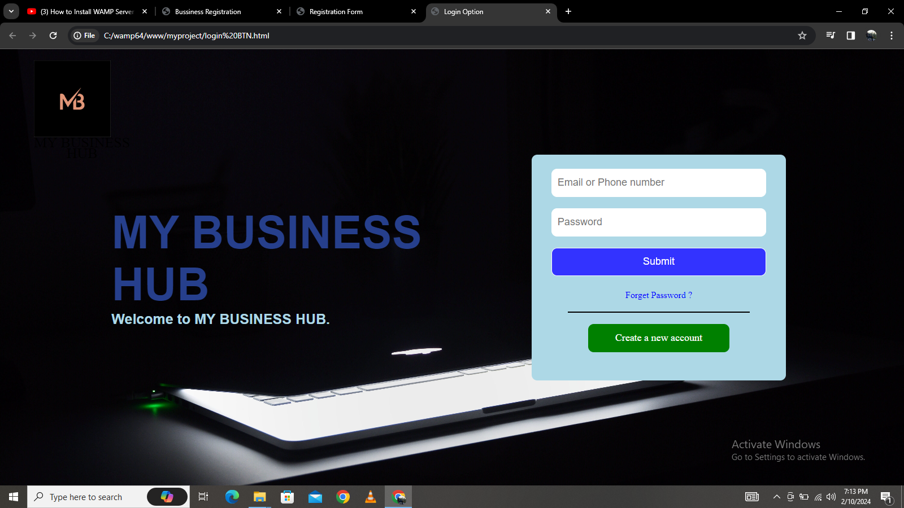
LOGIN PAGE

Slide 7
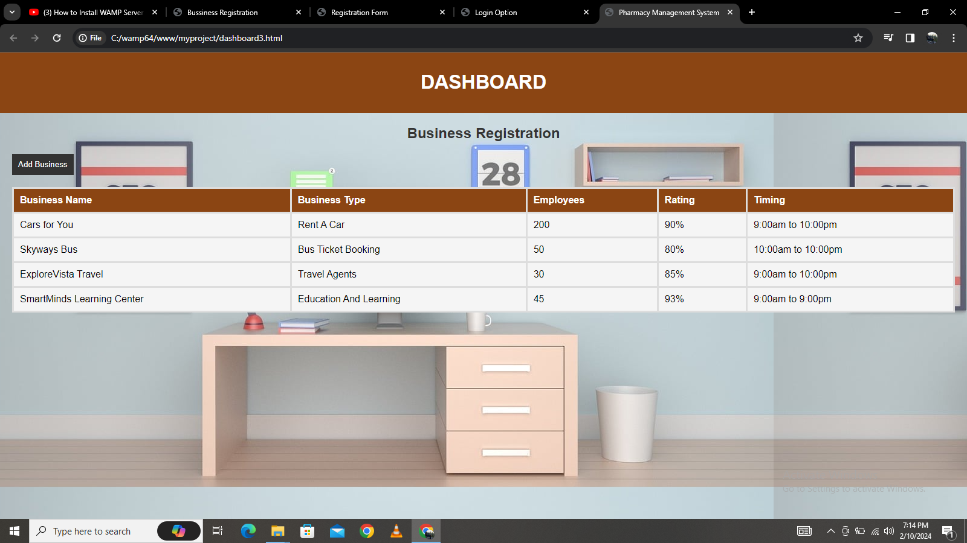
DASHBOARD

Slide 8
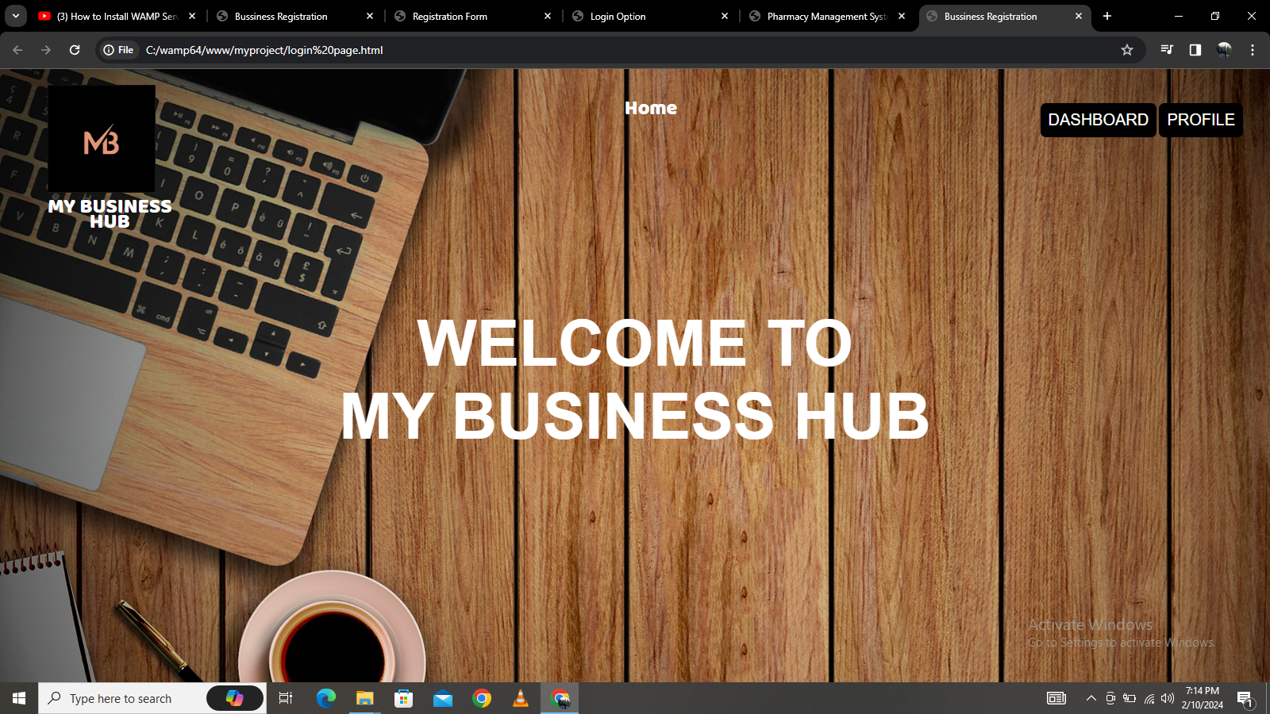
FRONT PAGE

Slide 9
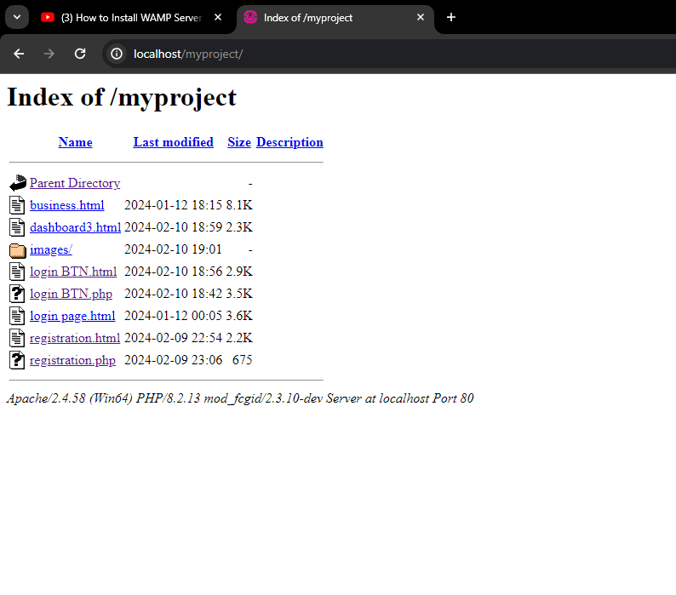
BACKEND DATABASE/PHP
INDEX PAGE:

Slide 10
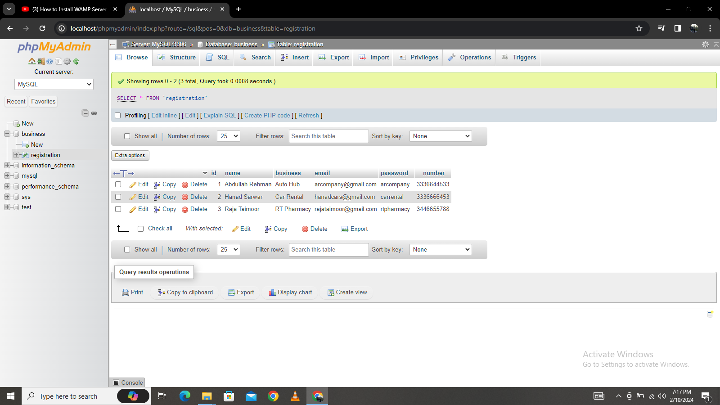
DATABASE

Slide 11
THANK YOU!

